Slide 1

Performance Testing Dashboard

Slide 2


Meet The Team
Dang Thi Thao My
Bui Nguyen Thien Khanh
Nguyen Anh Quan
Le Huynh Anh Tuan
1359042
1359041
1359049
1259027

Slide 3
Presentation Content:
Project Overview.
Solution
Milestone and Status
Individual Work Hours – Learn and Achievement.
Issues and Recommendations
Demo.

Slide 4

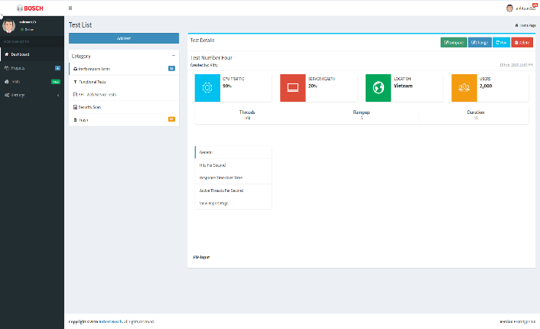

Project Overview
Performance Testing Dashboard
Client Robert Bosch

Slide 5
Project Description
User Authentication
Slave Machine Configuration
Jmx Script Management
Master Machine Configuration
Performance Testing Dashboard
Show Reports
Real-Time Report
Reports Comparison
Run Jmeter Script
Report Export

Slide 6
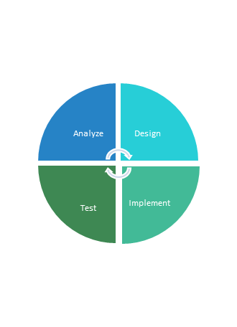

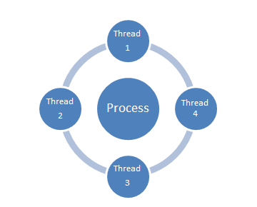



Technical Skill
Spring Framework
Software Development Process
Security, Spring MVC,
Template FreeMarker
Analyze, Design, Implement, Test
Source Code Control
Concurrency Programing
Using Git To Control
Our Source Code
MultiThread
Unit Test
Performance Testing - Jmeter
JUnit

Slide 7
Working as a Scrum Team
How to work in Professional Environment
01
02
Independence
04
03
Time Management
05
Problem Solving

Slide 8
Self-estimation
Time Work:
~400 hours per each member

Slide 9













Solution
{ REST }
Agent 1
Project
User
Test
Security
Agent 2
Script
Agent
…
Report
Jmeter Core
Web server/Master
Agent n

Slide 10
Solution
{ REST }
Agent 1
Project
User
Test
Security
Agent 2
Script
Agent
…
Report
Jmeter Core
Web server/Master
Agent n

Slide 11
Quality Assurance
Requirements Development
Post Delivery
Bug-fix
Reviews
Verification
Validation
Requirements Management
Testing
Design
Intergration
Coding

Slide 12
Project Milestone
Releases
2nd release
Minimum Viable Product
1st release
Final release
Other Milestones
M1
M2
M7
M8
M9
Envision
Sprint 0
Sprint 1
Sprint 2
Sprint 3
…
Sprint 12
…
Sprint 16
Closure
Key Milestone | Description | Planned date
M1 | Complete Gathering Requirements | 10/07/2016
M2 | Proposal approved | 10/20/2016
M3 | Complete Design | 10/24/2016
M4 | Prototype approved | 10/26/2016
M5 | Release 1 | 12/5/2016

Slide 13
Project Status
Requirement | State | Percentage of Done
User Authentication | Closed | 100%
User Management | In-progress | 50%
Script Management | In-progress | 70%
Report Management | Paused | 80%
Test Suite Management | In-progress | 30%
Real-time Report | In-progress | 30%

Slide 14
ISSUES
Believe in Kitties power!
Source Tree
Unit testing best practice
GIT problem
Data loss
Conflict
Small
problems
Unit test
Jmeter
War
Issue log
Properties file
Issues
Commit rules
Ask mentor
Research
Specify params
Distribution Testing
Complexity
No solution
Jenkins similarity
InfluxDB
Report req. expansion
Live with switch tabs
Unstable graph
New params
Current status

Slide 15
Recommendation
Keep your current performance!
5 Recommendations for the following time
What our team must focus is tracking what we have done and have yet done : Deliverables, Milestones, Unfinished Modules, Open Issues. Specifically:
Keep our current performance status
Have a good relationship with client
Track project metrics to take instant action and keep the project complete on schedule
Keep contact with supervisor
Continue on managing risk, issue and change request
Target
Tracking
Document
Team
Product
Notes:
cont' on managing risk, issue, change request
Track project metrics in order to take appropriate actions and keep project complete on schedule

Slide 16
THANKS FOR LISTENING !!!

